Slide 2
What’s new in Remote Desktop Services for Windows Server 2019
BRK2242
Christian Montoya | Program Manager

Slide 3
Agenda
RDS 2019 and Windows Virtual Desktop
Progression of RDS on Azure
Enhancing end-user client experience
RDSH improvements

Slide 4
RDS 2019 and Windows Virtual Desktop
Windows Virtual Desktop ideal if you want…
Microsoft to manage the brokering platform as a service
Windows 10 Enterprise multi-session capabilities, free Windows 7 ESU
Office365 ProPlus capabilities
RDS 2019 ideal if you want…
full end-to-end control of the desktop virtualization environment
in-place upgrade of existing Windows Server RDS environment
to extend current deployments

Slide 5
Progression of RDS on Azure

Slide 6
RDS on Azure
230% YoY growth in Azure compute hours

Slide 7


RDS 2012 R2
We’re up and running!
RD Clients
Remote Desktop Services 2012 R2
Web access
Broker
Desktops
User Profile
File Server
FIREWALL
Gateway
Apps
RD infra
User environment
VMs
SQL DB
Windows Server AD
Domain Services

Slide 8



RDS 2016
First step towards true Azure integration and optimization.
RD Clients
Remote Desktop Services 2016
UPD
Web access
Broker
Desktops
User Profile
File Server
FIREWALL
Gateway
Apps
RD infra
User environment
VMs
Azure SQL DB
Windows Server AD
Domain Services

Slide 9

RDS 2019
Continued investments in Azure as the ideal hosting environment.
RD Clients
Remote Desktop Services 2019
Web access
Broker
Desktops
User Profile
File Server
FIREWALL
Gateway
Apps
RD infra
User environment
VMs
Azure Key Vault
Azure SQL DB
Windows Server AD
Domain Services

Slide 10
RDS certificates with Azure Key Vault
Store certificates in Azure Key Vault
Create VMs and load certificates
Run updated Set-RDCertificate cmdlet with certificate thumbprint

Slide 11
Demo: RDS certificates with Azure Key Vault

Slide 12

RD Licensing enhancements
License server can update per-user licenses without direct AD connectivity
[Preview] Highly-available RD license server role with SQL DB
Licensing program rolling out for Cloud Solution Providers (CSP)

Slide 13

RDS 2019 with ARM templates
ARM templates for basic and high-availability deployment
Plan to be update with RDS 2019 post-GA

Slide 14
Demo: RDS ARM templates

Slide 15
Enhancing end-user client experience

Slide 16
Enhancing end-user experience
RDS web client
GPU virtualization
RDP improvements

Slide 17
Demo: RDS web client

Slide 18
GPU virtualization

Slide 19
GPU virtualization
Power users
Professional users
Knowledge workers
Task workers
GPU Utilization Per App
User scale

Slide 20
Graphics virtualization technology evolution
Windows Server 2012 R2
Windows Server 2016
Windows Server 2019
RemoteFX vGPU
DX 11.1 support
Higher video memory
Up to 2560 × 1600 resolution
Scale improvements
RemoteFX vGPU
OpenGL 4.4/OpenCL 1.1
1 GB dedicated VRAM
Up to 4K resolution
Server VM support
Discrete Device Assignment (DDA)
Native GPU driver support
Full API support
DDA
Improved RDSH scalability with GFX HW acceleration
Use all available GPUs
Improvements on video detection and handling
Region classification improvements
High DPI downsampling

Slide 21
DDA and RemoteFX vGPU in WS2019
DDA
Primary story for GPU acceleration in WS2019
Enhanced security and isolation
Guaranteed GPU performance
API compatibility (DirectX 12, OpenGL)
We are continuing to evaluate GPU-P drivers for VDI and RDSH
RemoteFX vGPU
Deprecated in WS2019
Clean OS installation cannot share RemoteFX vGPUs with new Hyper-V VMs
Upgrade warning if RemoteFX vGPU is enabled in the upgraded OS
If you had a RemoteFX vGPU-enabled VM it will continue to work after upgrade
Admins can remove RemoteFX vGPU after upgrade to WS2019

Slide 22
Improvements in RDP

Slide 23
Video and graphics improvements
Video playback always uses hardware acceleration
Smooth playback when moving the video window
4K downsampling

Slide 24
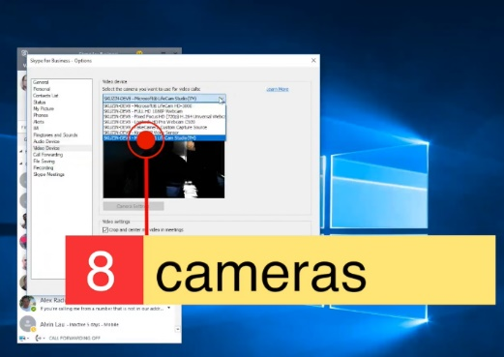
Device redirection
High-level redirection of built-in or attached video camera
Less network bandwidth compared to USB camera redirection
Increased video framerate, up to 30 fps
Redirect multiple cameras
Improved printing messages
Built-in Windows client first to adopt

Slide 25
Demo: RDP experience in RDSH 2019

Slide 26
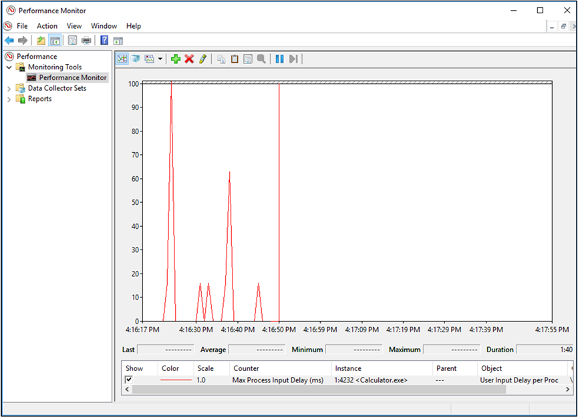
User Input Delay performance counters
Another measure to troubleshoot poor application performance
Correlate with other perfmon counters (Active Sessions, CPU, etc.)
Enabled by default in WS2019 RDSH and Windows 10, version 1809

Slide 27

Summary: RDS 2019
Continued investment in RDS platform and scenarios with Azure
Access your environment anywhere with the web client
Receive enhanced user-experience through constant improvements in protocol and clients
Leverage ARM templates to deploy and maintain RDS environment

Slide 28
Resources
Tools
Install RDS web client: https://aka.ms/rdwebadmindocs
Utilize RDS ARM templates: https://aka.ms/rdautomation
Docs
Remote Desktop Services Docs: https://aka.ms/rds
Windows Virtual Desktop information: https://aka.ms/wvd
Blog
https://aka.ms/rdblog

Slide 29
Call to action
Continue deploying RDS on Azure!
Register for the public preview via aka.ms/wvdpreview
Consider attending the following sessions:
Tuesday 11:20am – Desktop Virtualization updates with Windows 10 and Microsoft 365 (THR2316)
Tuesday 14:00pm – What’s new and what’s next in Windows virtualization (BRK2300)
Thursday 4:00pm – Windows Virtual Desktop Deep Dive (BRK3312)
Thursday 10:45am – Office in Virtual Desktop environments (BRK3087)
Thursday 9:35am – Virtualization for modern desktops (THR2302)
Friday 9:00am – What's new in Remote Desktop Services on Windows Server 2019 (BRK2242)
Friday 10:15am – New multi-session virtualization capabilities in Windows (BRK2424)
Friday 11:30am – Migrate your virtualized client application to Azure (BRK2243)

Slide 30
Please evaluate this session Your feedback is important to us!
Please evaluate this session through MyEvaluations on the mobile app or website.
Download the app: https://aka.ms/ignite.mobileApp
Go to the website: https://myignite.techcommunity.microsoft.com/evaluations

